Slide 1
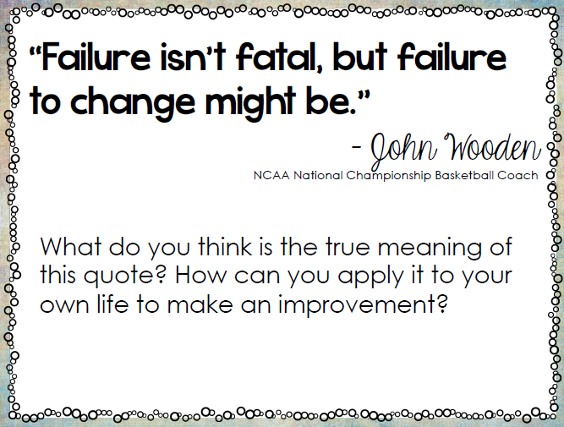
Welcome Work 12/4/2017

Slide 2
Essential Question:
How successful were the Americans in obtaining their goals in the Revolutionary War?
SS.8.A.3.6

Slide 3
Treaty of Paris 1783

Slide 4
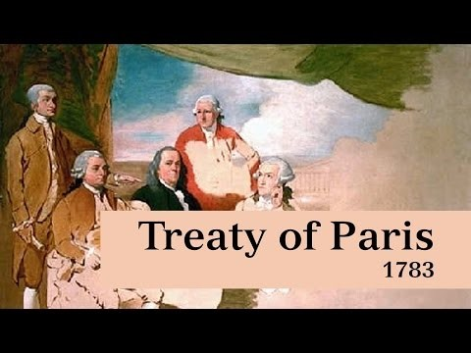

Slide 5
The End of the War
The Battle of Yorktown did not end the American Revolution.
The Treaty of Paris officially ended the American Revolution.
A treaty is a written agreement between countries.
Why was the meeting held in Paris?

Slide 6
Work Begins on the Treaty
Work on the Treaty of Paris began in April 1782.
Richard Oswald represented the British at the meeting.
Benjamin Franklin represented the United States.
Each man presented the terms of their country for the agreement.

Slide 7
What did the Americans want?
The British had to accept American independence.
All British soldiers must leave America.
Ben Franklin said Americans might feel better toward the British if they paid for those towns that were destroyed in the war.

Slide 8
What did the British want?
The British asked that Loyalists who chose to remain in the United States be treated fairly.
Is this all the British wanted?

Slide 9
Negotiations
Richard Oswald and Benjamin Franklin negotiated or talked with one another to work out an agreement.
They discussed the terms for more than a year.
The Treaty of Paris was signed on September 3, 1783

Slide 10
The End Results
Tweety of Paris Activity
As a group, you will look at the excerpts from the Treaty of Paris 1783 and analyze the text to decide what each of the 10 articles of the Treaty meant.
Then you will create “Tweet” for each of the 10 articles and write it on your poster.
Be ready to present!

Slide 11
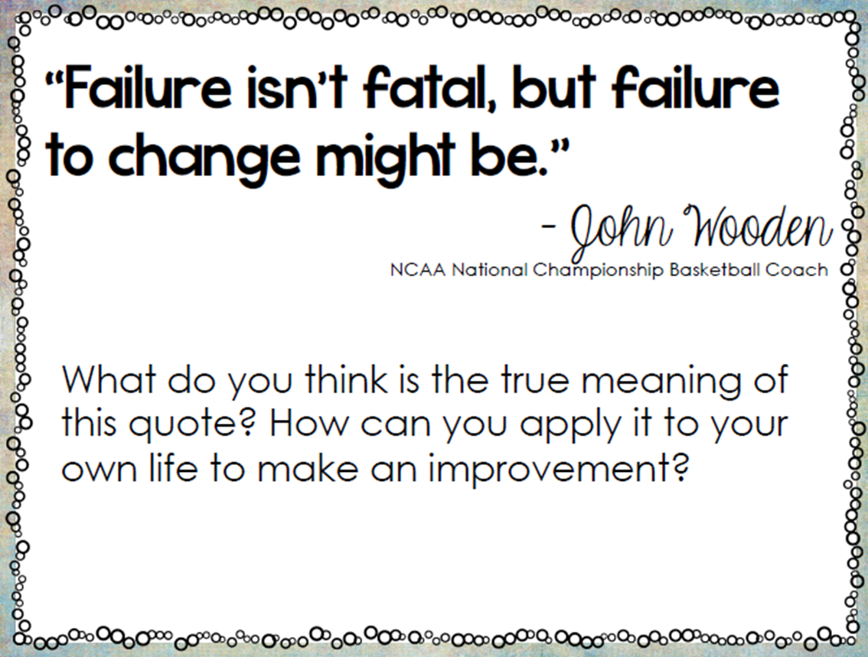
Exit Ticket
In your “Welcome Work” underneath today’s questions – I want you to relate the day’s quote to the Revolutionary War. Make connections!

