Slide 1
Essential Question
How were both consensus and compromise evident at the Constitutional Convention?
SS.8.A.3.9

Slide 2
COMPROMISES
Turn to your shoulder partner and talk about a time when you had to make a compromise.
What did you learn?
How did you come to a compromise?

Slide 3
When the Founding Fathers met to make amendments to the Articles of Confederation, they found the process too tedious. They decided to scrap the current plan of government and start over. What they create is known as the United States Constitution, and it is the result of FOUR major compromises between different factions.

Slide 5
The Virginia Plan
Edmund Randolph
Bicameral (two house) legislature
Representation in both houses based on state’s population
Greatly favors large (population) states

Slide 6
The New Jersey Plan
William Patterson
Unicameral (one house) legislature
Representation based on equality; each state gets 1 representative
Very similar to old system under Articles of Confederation
Favors small states, since their vote would be swallowed up under VA Plan

Slide 7
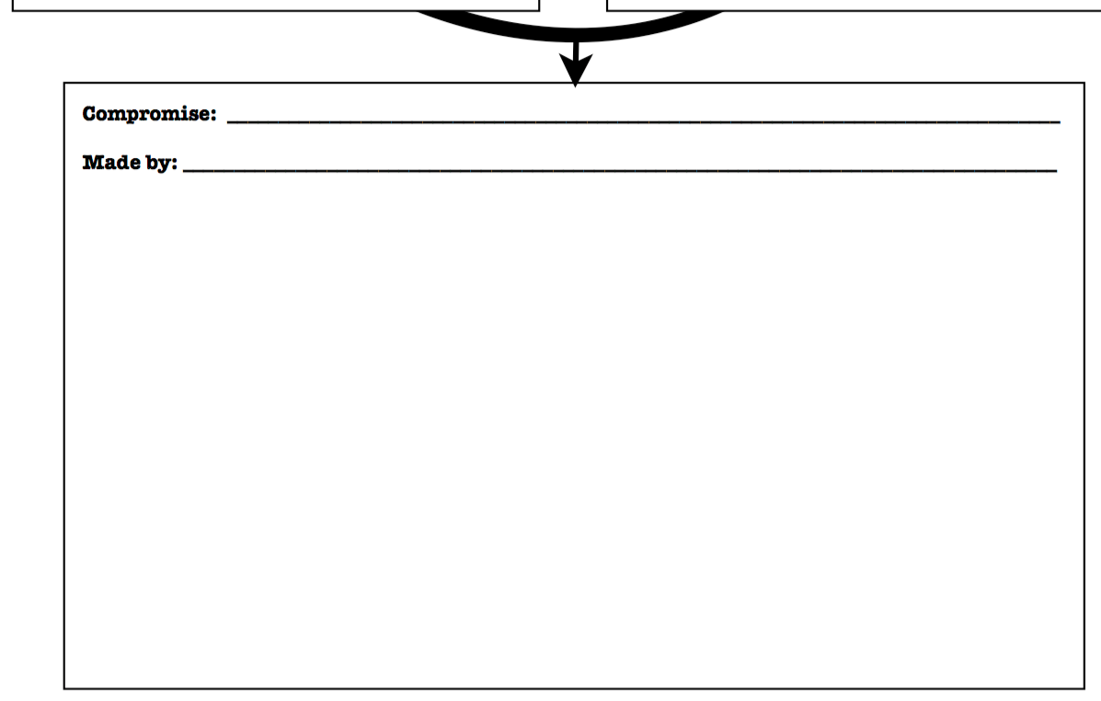
The Great Compromise
(The Connecticut Compromise)
Roger Sherman
Creates bicameral legislature
Upper house (Senate) based on equality
Each state receives 2 senators
Serve 6 year terms
Lower house (House of Representatives) based on a state’s population
A representative for every 30,000 people
Serve 2 year terms

Slide 9
Slaves Count!
Southern States
When counting a state’s population, slaves count just as a free person would
Favors slave states
Would give slave states more representatives in the House

Slide 10
No slaves!
Northern States
Slaves should not count at all when determining a state’s population
If south can count property, can the north count horses and cattle too?

Slide 11
The 3/5 Compromise (the three-fifths compromise)
Roger Sherman
Each slave will count as 3/5 of a person when determining a state’s population for representation purposes
For example, if a state has 50k slaves, their population would go up an additional 30k (an extra representative, vote)

Slide 13
In the North!
Alexander Hamilton
Wants national capital in New York or Philadelphia
Also wants national government to assume all of state debt incurred during Rev War
Would help standing throughout world; countries deal with US instead of states

Slide 14
In the South!
Thomas Jefferson, James Madison
Fear capital in north would lead to it favoring interests
Southern states already repaid war debts – why should we help the north?

Slide 15
The Compromise of 1790
Hamilton, Jefferson, Madison
Capital will not be in any state, so no state can be shown favoritism
Capital will go to the South, along Potomac River in between MD and VA.
South agrees to let government assume all war debt, essentially agrees to help north repay debt

Slide 16
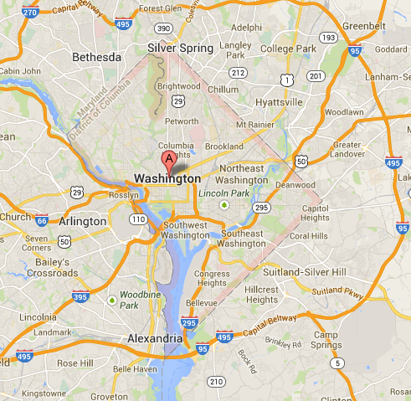

Slide 17
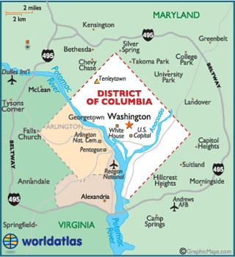

Slide 19
A list of all rights guaranteed to people!
Anti-Federalists
New Constitution needs list of rights guaranteed to citizens
What if this strong government behaves like our old king?

Slide 20
A list is unnecessary!
Federalists
The Constitution provides for three branches of government and a system of “checks and balances.” This is enough protection.
If we attempt to list all the rights the people have we will undoubtedly forget some
Better to list none then try to list all

Slide 21
Will
A Bill of Rights is added
Thomas Jefferson
A list of freedoms guaranteed to all Americans is added; these are rights that can never be taken away
These 10 rights were added to the Constitution as amendments. These are changes made to the Constitution.

