Slide 1
Essential Questions
What were the advantages and disadvantages of the North and South going into the Civil War?
What were the war aims and strategies of the Union and the Confederacy entering the war?
SS.8.A.5.5

Slide 2
Strengths & Weaknesses of the Union and the Confederacy!

Slide 3
CATEGORY | NORTH | SOUTH

Slide 4
CATEGORY | NORTH | SOUTH
Other Names
No. Of States
Population
Leadership
Railroads
Confederacy, Confederate States of America, CSA
Union, United States of America, USA
23
11
9,000,000
(includes 3,500,000 slaves)
22,000,000
Abraham Lincoln
Jefferson Davis
75% of nation’s
railroads
25% of nation’s
railroads

Slide 5
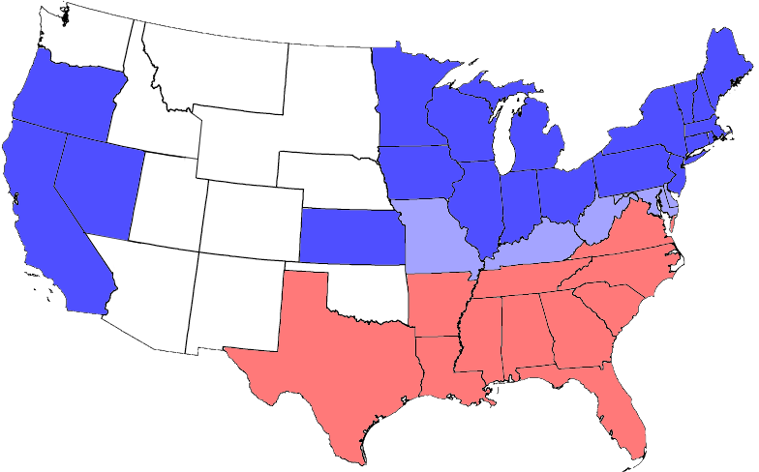
Border State: state that allowed slavery but did not secede the Union.

Slide 6
Robert E. Lee
Stonewall Jackson
- well trained, experienced
Generals
Capital
Army
Navy
Cause for fighting?
Ulysses S. Grant
George McClellan
-inexperienced
Richmond, VA
(briefly in
Montgomery, AL)
Washington, D.C.
1,500,000 army
1,000,000 army
Large Navy which grew larger as war progressed
No navy at
wars start
- Maintain “southern way of life,” which includes slavery
- Preserve the country
- Free the Slaves

Slide 7
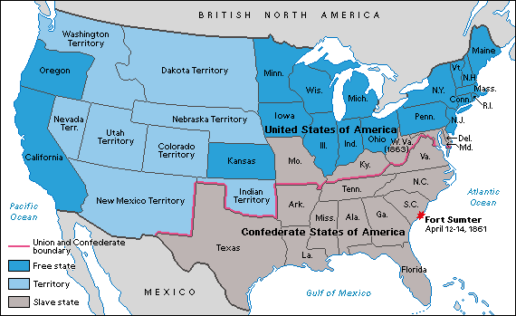

Slide 8
What is the game plan?
Strategies of the Union
and Confederacy!

Slide 9
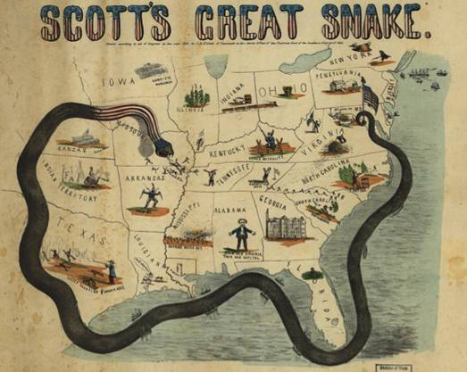
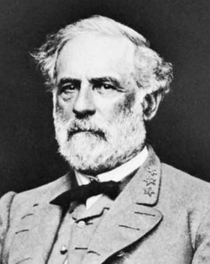
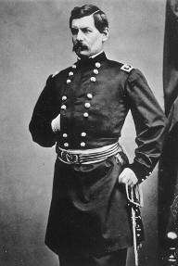
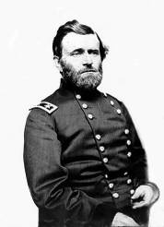
Winfield Scott’s Anaconda Plan
Take the CSA capital at Richmond
Take control of the Mississippi River
Robert E Lee leads the Army of Northern Virginia
Southern strategy was an “offensive defense”:
Ulysses Grant, William Tecumseh Sherman and Army of the Tennessee in the West
George McClellan was in charge of Army of the Potomac
Hopefully attract a foreign ally (Britain, France?)
We broke away – you want us, come get us!
- Drag the war out! Eventually, northerners will get sick of it!
- Attack strategically! At some point, we want to win a battle in the north!
Divide the West from South
Blockade the Southern coast
Notes:
Use placemat consensus for the Anaconda Plan…

