Slide 1
Welcome Work
In your ISN on a new page spread titled “Nullification Crisis”…
Essential Question:
How did Andrew Jackson handle the nullification crisis over tariffs, and how did the crisis foreshadow a future civil war?

Slide 3
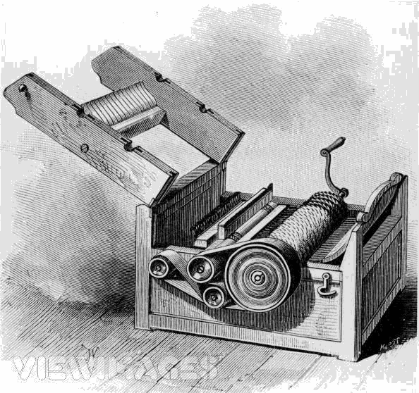
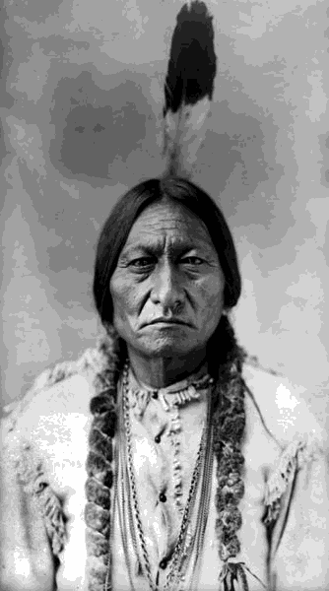
The cotton gin made cotton profitability sky rocket and turned more and more slave owners to cotton production. How did the invention of the cotton gin effect Native Americans?
Making Connections…

Slide 4
Define these words
in your text packet:
- tariff
nullify
secede
state's rights theory
- compromise

Slide 5
As a group, define these words
in your notebook:
- Tariff - a tax on imported goods
Nullify - to make legally null and void, to cancel it
Secede - to withdraw from an organization
state's rights theory – the idea that states are superior to the national government, and do not have to follow its laws
- Compromise – to agreement (or settlement) between two sides

Slide 6
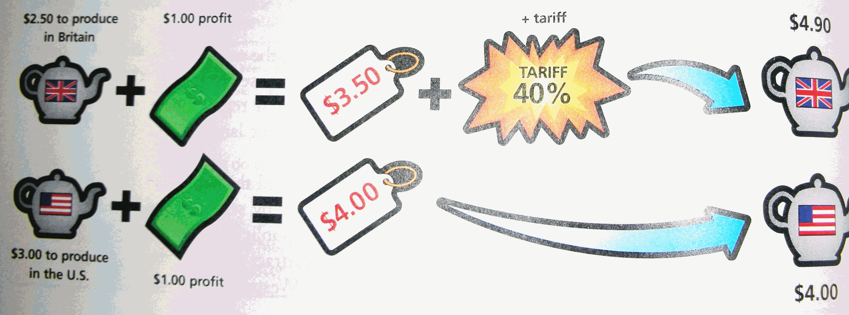
How do Tariffs work????

Slide 7
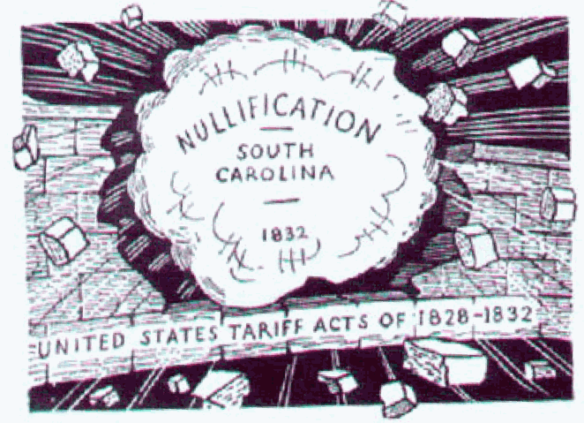

Slide 8
Views on Tariffs
North | South

Slide 9
Jackson passed the Tariff of 1828 (tariff of abominations) to help business
South Carolina wanted to nullify the tariff
S.C. threatened to secede from the Union
Jackson lowered the tariff to avoid disaster

Slide 10
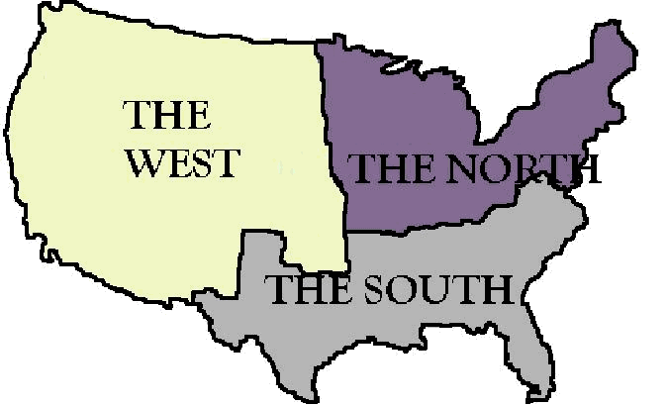
How does the Nullification Crisis represent sectionalism in the U.S. ?

Slide 11
A Letter to President Jackson…
In 5-7 sentences, write a letter to President Jackson where you show the Northern Perspective in this crisis.
THEN…
In 5-7 sentences, write a letter to President Jackson where you show the Southern Perspective in this crisis.

Slide 12
Make a filmstrip of the Nullification Crisis!

