Slide 1
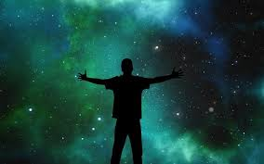

Slide 2
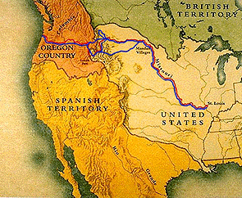
The Louisiana Purchase and the Corps of Discovery

Slide 3
The Deal:
How did the United States gain control over the Louisiana Territory?
President Jefferson had purchased all of the Louisiana Territory from Napoleon of France for 15 million dollars.
Jefferson only wanted New Orleans because of its importance to US trade, but Napoleon wanted out of the Americas so he sold it all!
The Louisiana Purchase doubled the size of the United States!

Slide 4
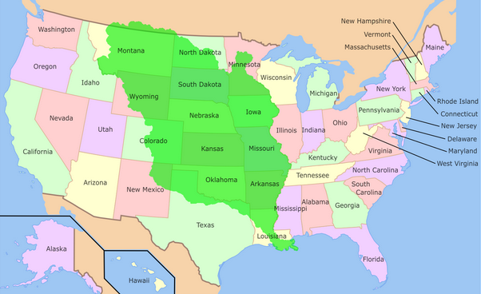
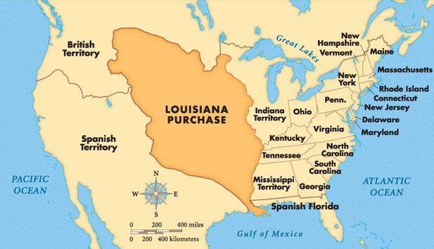
The Louisiana Purchase doubled the size of the United States!
Quick Question:
What modern day states were carved out of the land purchased in this deal?

Slide 5
The Expedition:
What was exploring this territory like?
The purpose of the expedition was to explore the new territory.
Jefferson asked his personal secretary, Meriwether Lewis, to lead the expedition. Lewis asked his old army friend, William Clark, to co-lead the expedition with him. This group was called the Corps of Discovery.

Slide 6
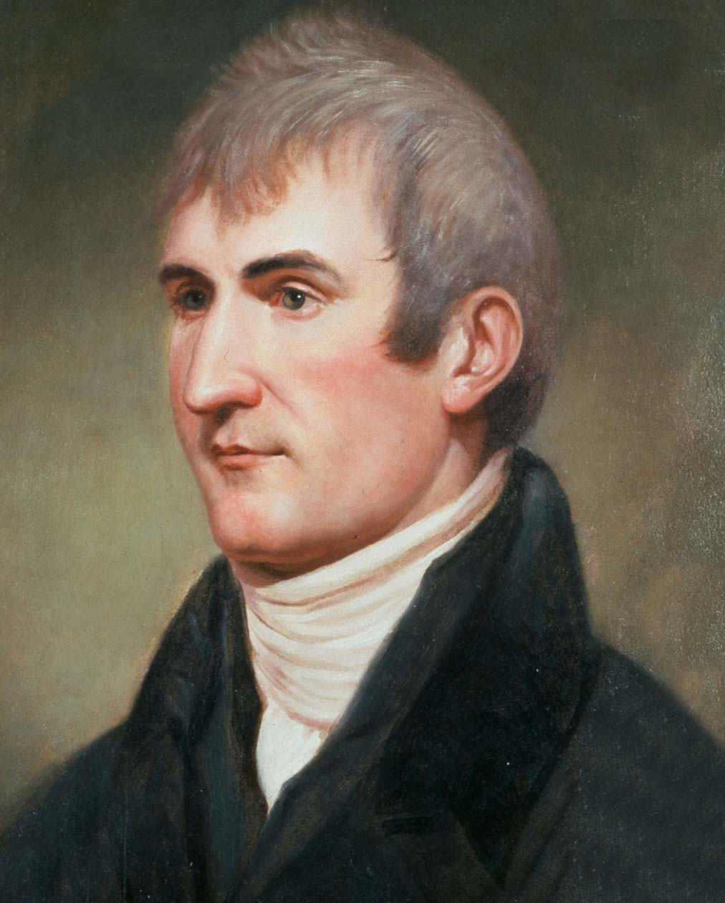
Captain Meriwether Lewis
Was born in 1774.
He joined the army at 20 years old.
He was made President Jefferson’s personal assistant in 1801 and was asked to lead the Corps of Discovery.
Lewis was the scientist on the journey, keeping detailed records of the plants and animals they found.

Slide 7
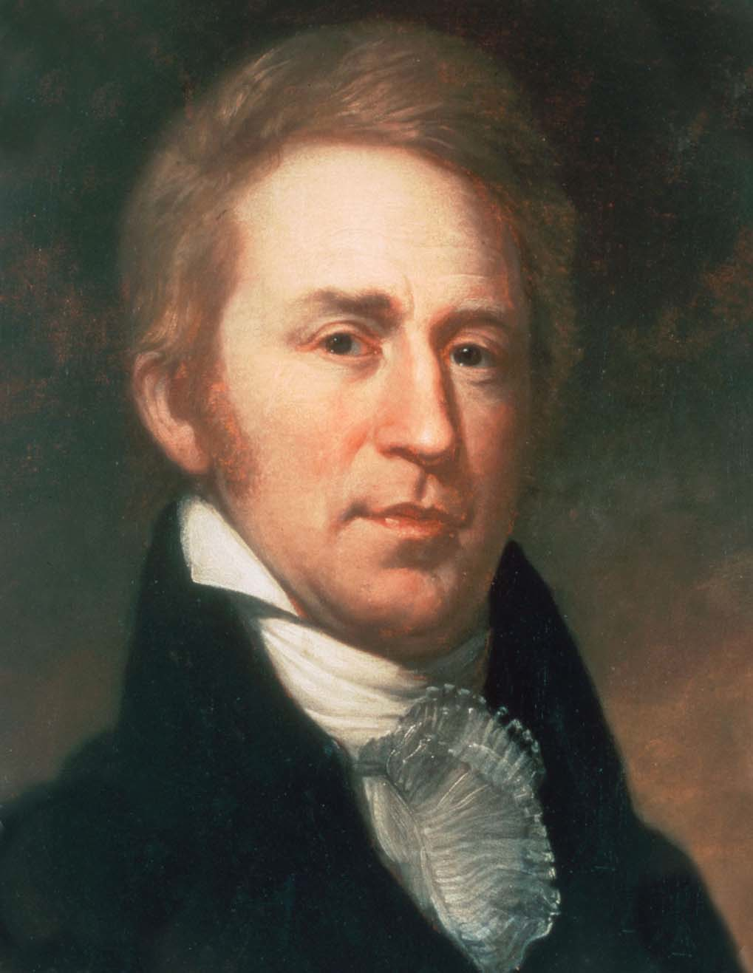
William Clark
Was born in 1770 and at 19 joined the military.
Clark met Meriwether Lewis when they were both in the army.
Lewis asked Clark to help him lead the expedition across the country.
Clark was the geographer on the trip, keeping a detailed diary including many drawings and maps.

Slide 8
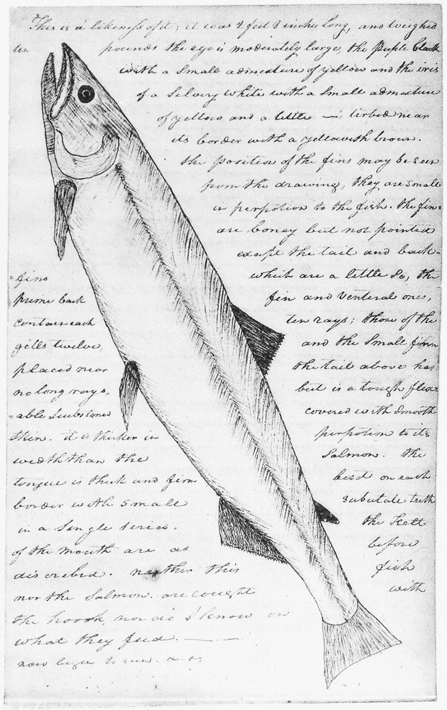
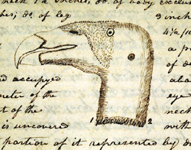
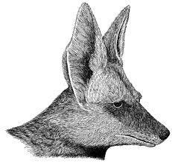
Here are some pictures and descriptions made by Meriwether Lewis!

Slide 9
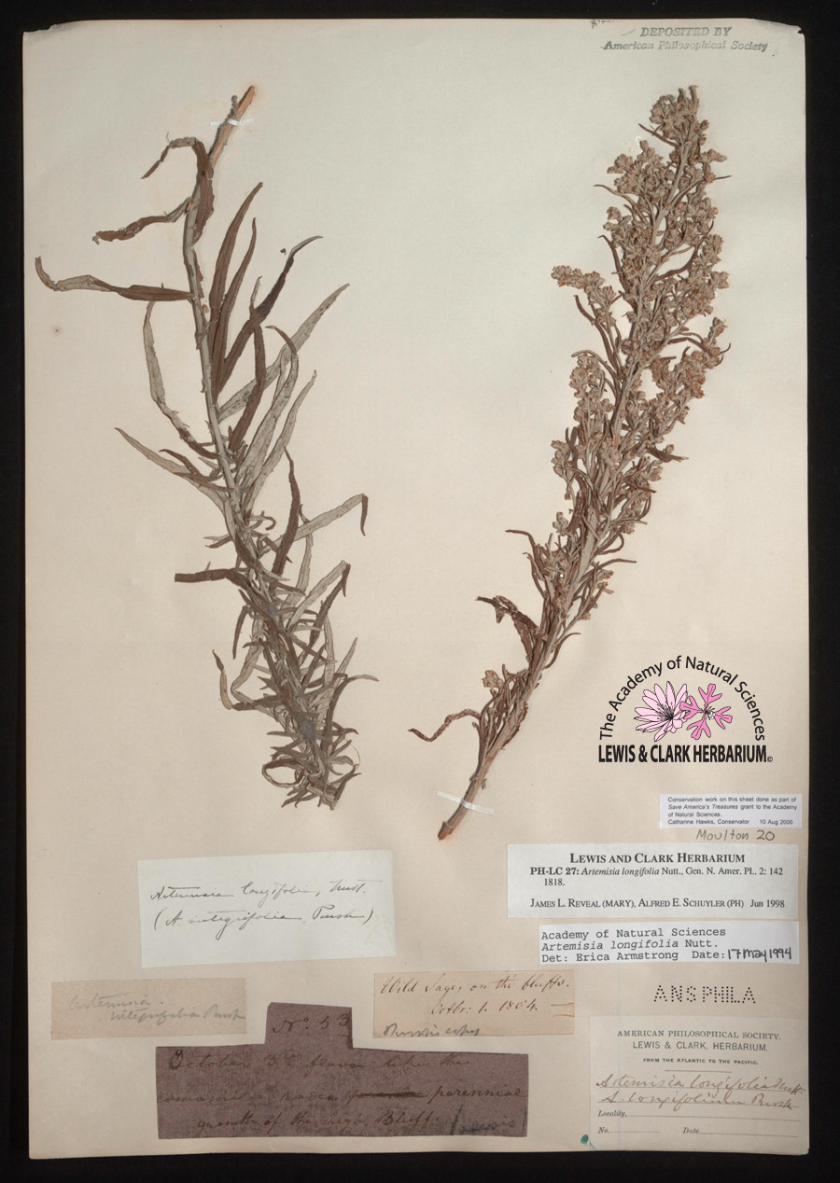
Here are some pictures and descriptions made by Meriwether Lewis!

Slide 10
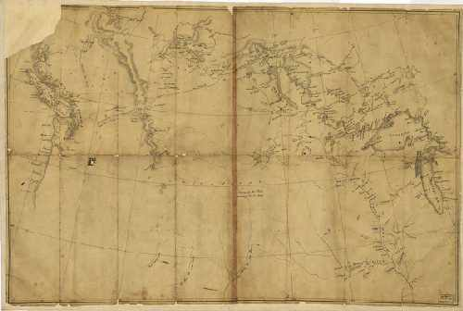
Here are two maps made by William Clark on the expedition!

Slide 11
Toussaint Charbonneau
A French Canadian fur trader. He had lived among the Indians since 1796.
He had a captive Shoshone Indian “wife”. She had been captured by a Hidatsa war party about 1800, and sold as a slave to Toussaint. Her name was Sacagawea. She was approximately 16 years old in 1804.
Charbonneau would act as interpreter during the expedition.

Slide 12
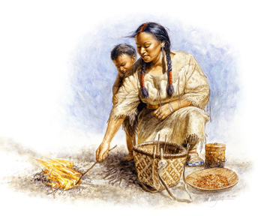
Sacagawea
Was 12 when she was kidnapped and sold into slavery and about 16 when she “married” Charbonneu.
She would serve as interpreter on the journey.
Sacagawea had a son during the expedition.
Sacagawea’s image was made into a dollar coin in 1997.
She was honored as a very important part of the Corps of Discovery.

Slide 13
Sacagawea Dollar Coin
Do you have any of these?

Slide 14
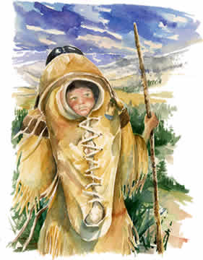
Jean Baptiste Charbonneau
Jean Baptiste Charbonneau was the son of Toussaint Charbonneau and Sacagawea.
He became the youngest explorer on the Corps of Discovery.
Clark nicknamed him “Pomp” from the Shoshone word meaning “leader.”

Slide 15
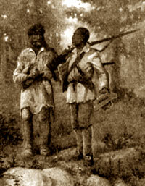
York
York was Clark’s childhood companion and his “manservant”, which meant he was a slave.
We know he was big, very athletic, and a great dancer.
He was devoted to William Clark and was a great help to the expedition because of his natural curiosity of the unknown land.

Slide 16
More about York
Indians had never seen a black man before. There is a painting in the Mandan lodges of the Mandan chief trying to rub the black off of York’s skin.
York was finally set free ten years after the expedition ended.

Slide 18
The Goals of the Expedition:
To find a water passage that stretched across the entire continent. They thought the Missouri was it, however they found that the source was in the Rocky Mountains. No such passage exists.
To make accurate maps of the new territory and the western lands along the way. They were successful!
To make peace with the Indians along the way. They were successful!
To document new plants, animals, and food discovered on the journey. They were successful!

