Slide 1
Happy Friday!
Please turn in your Slave Quilt Square.
Have your ISN out to the questions and answers from yesterday.

Slide 2
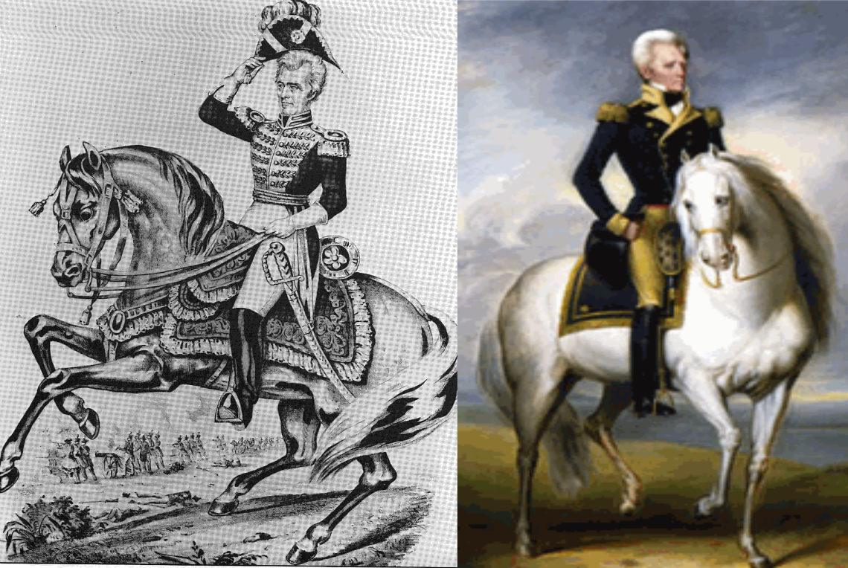

Slide 4
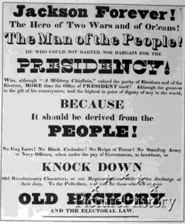

Slide 5
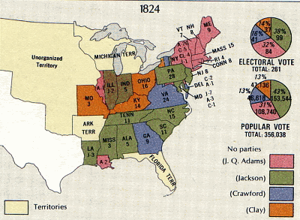

Slide 6
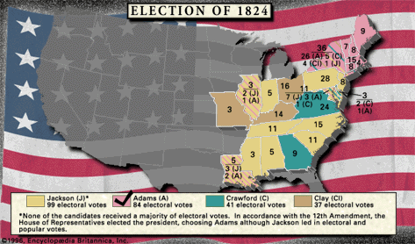

Slide 7
The Election of 1824
Jackson referred to this election as a "corrupt bargain”
Jackson won the popular vote but
Congress chose Adams to be President

Slide 8
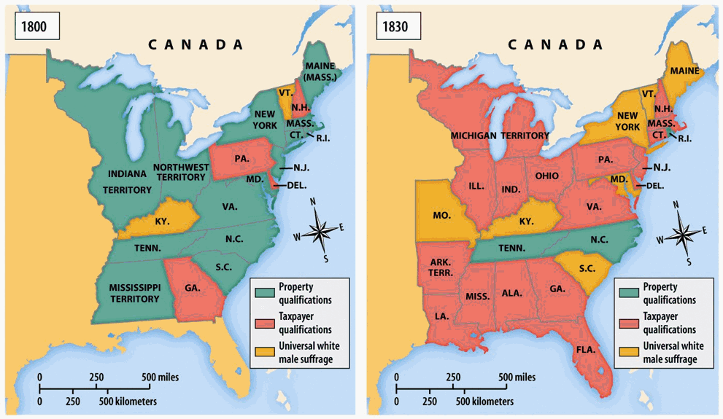

Slide 9
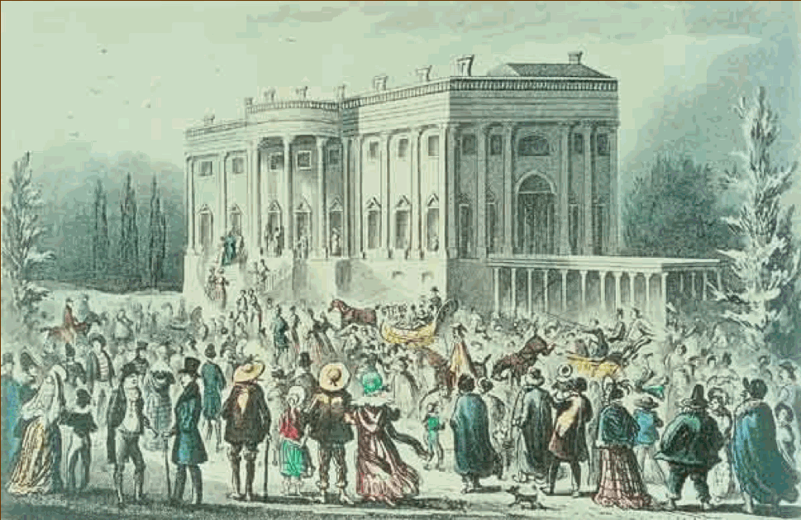

Slide 10
Video

Slide 11
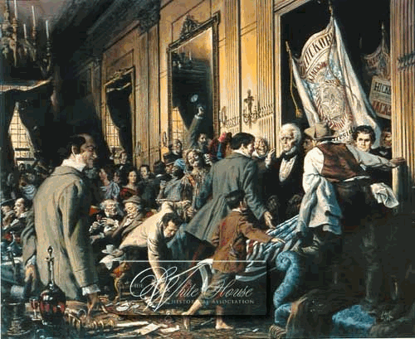

Slide 12
Jacksonian Democracy: the idea of spreading political power to all people - so all people have a say in the government

Slide 13
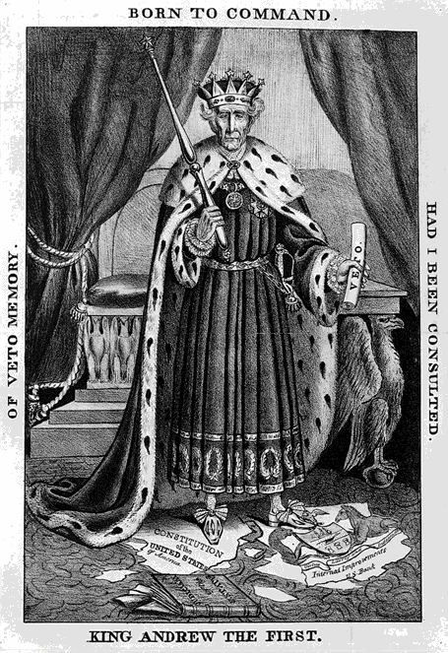

Slide 14
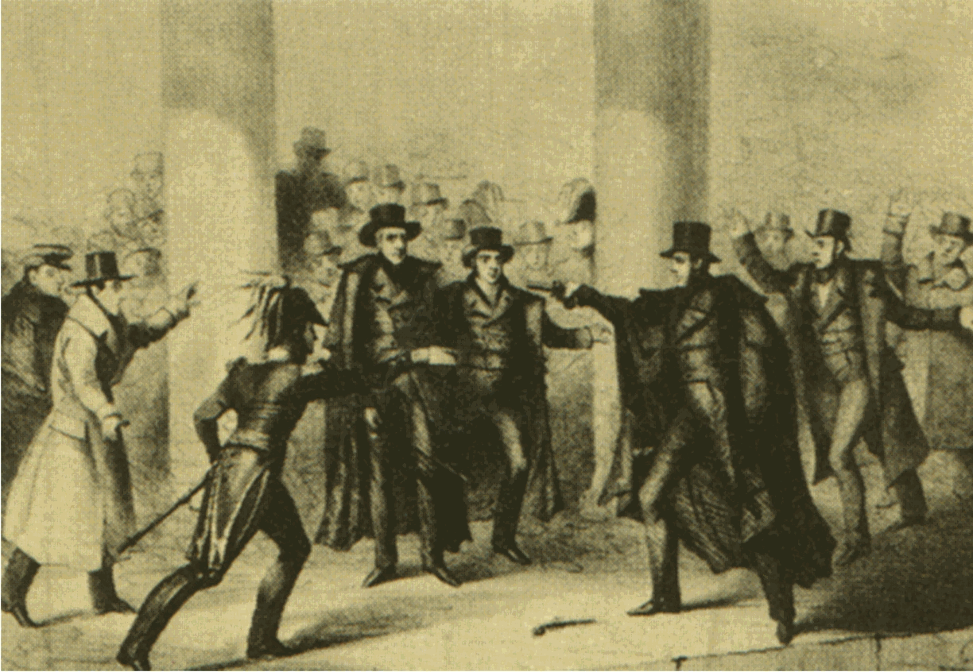

Slide 15
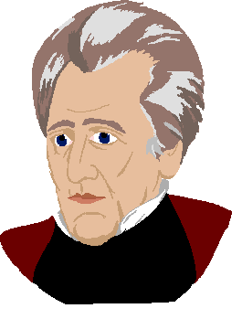
"To the victors go the spoils"
Jackson began the spoils system - practice of a successful political party giving public offices to its supporters

Slide 16
T/F
___ Jackson lost the Election of 1824 fair and square
___ Jackson opened democracy to all people
___ As many people came to Jackson's inauguration, it soon became chaos
___ Jackson lived a poor and modest life like most citizens
___ All Americans loved Jackson
___ Jackson created the spoils system to give ordinary Americans the power to make decisions in their government

