Slide 1
Essential Question
Are all governments created equal?
SS.8.C.2
“Forms of Government”

Slide 2
Have you ever thought about what life would be like without government?
What are the positives? What are the negatives?

Slide 3
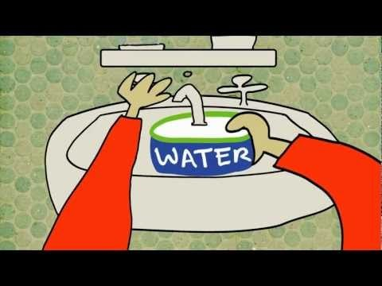

Slide 4
Types of Governments
Monarchy

Slide 5
Types of Governments
Anarchy
https://www.youtube.com/watch?v=YmThnIrIJ7A

Slide 6
Types of Governments
Anarchy
No government
Believes that a lack of government does not mean a lack of order
Believes it is the rules and laws created by government that creates criminals
Believes man is naturally cooperative

Slide 7
Democracy
Direct Democracy
Representative Democracy

