Slide 2
https://www.youtube.com/watch?v=_Ee1RAhDm3w

Slide 3
Welcome Work!
Please get out your ISN
Title: “A Call to Arms”
Essential Question:
How did the colonial leaders respond to British control of the colonies?
Standards: SS.8.a.3.2; ss.8.a.3.3; ss.8.a.3.4

Slide 4
A Call to arms
Unit 3 – Road to the American revolution

Slide 5
Essential question?
How did the colonial leaders respond to British control of the colonies?
Standards: SS.8.a.3.2; ss.8.a.3.3; ss.8.a.3.4

Slide 6
Quick Review
What has happened up to this point?
Did Parliament Have The Right To Tax The Colonies?

Slide 7
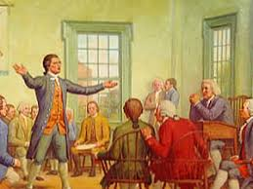
The Continental Congress
September 1774
55 men arrived in Philadelphia
All colonies Except Georgia
Came to establish a political body to represent Colonial interests and challenge british control

Slide 8
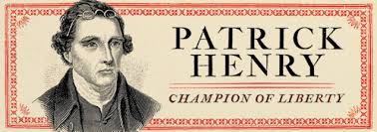
The continental congress
Major political leaders from all the colonies
John adams – Massachusetts
Patrick henry – virginia
George washington

Slide 9
The continental congress
Drafted a statement of grievances to repeal 13 acts of parliament passed since 1763
Declared the laws violated colonists’ rights
Voted to boycott all british goods and trade
Endorse the Suffolk resolves
People to arm themselves formed militias

Slide 10
Would war come?

Slide 11
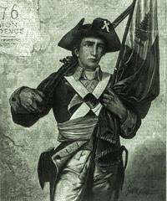
The first battles
Colonists believed if war broke out it would be new England first
Militia companies held frequent training
Some companies known as minutemen
Boasted that they were ready to fight in a minute’s notice!

Slide 12
The first battles
Britain also prepared for battle
King George announced to parliament that the new England colonies were “in a state of rebellion”
April 1775, British general sir Thomas gage had several thousand soldiers around boston with more on the way!

Slide 13
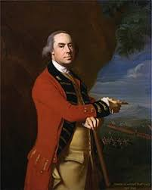
concord
General gage had instructions to take away all weapons from colonists, arrest leaders
Heard of arms and ammunition being stored in concord
Ordered 700 troops to march

Slide 14
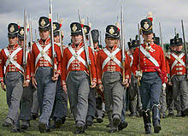
concord
Evening april 18, 1775, Dr. warren walked boston to check on british army
Saw british regiments form and march out of city
Alerted paul revere & William dawes

Slide 15
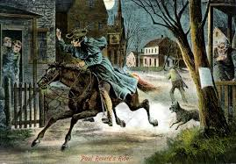
Midnight ride
Paul revere rode to Lexington to warn Samuel adams & john hancock
As he rode shouted “The regulars are out” to the people and houses he passed.
When he reached adams – adams was ready to fight for independence!

Slide 16
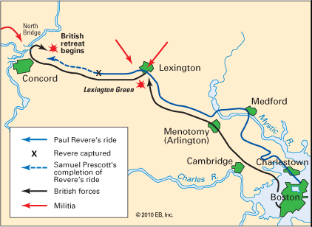

Slide 17
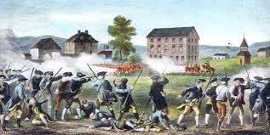
Lexington and concord
When redcoats approached Lexington they discovered a group of 70 minutemen led by Captain john parker
A shot fired…???...
“shot heard around the world”
8 minutemen dead after a volley of shots

Slide 18
Lexington and concord
British continued marching to Concord
Found no weapons or ammunition
It disappeared????
British destroyed anything remaining at location
As british moved, minutemen followed and kept firing on the british
Redcoat casualties: 174 wounded, 73 dead
War had begun!

Slide 19
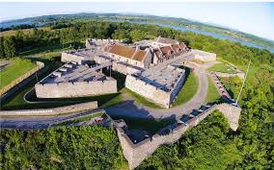
More military action
Benedict Arnold tasked to seize fort Ticonderoga
Strategically located
Rich in military supplies
Joined ethan allen’s green mountain men
Garrison surrendered may 10, 1775

Slide 20
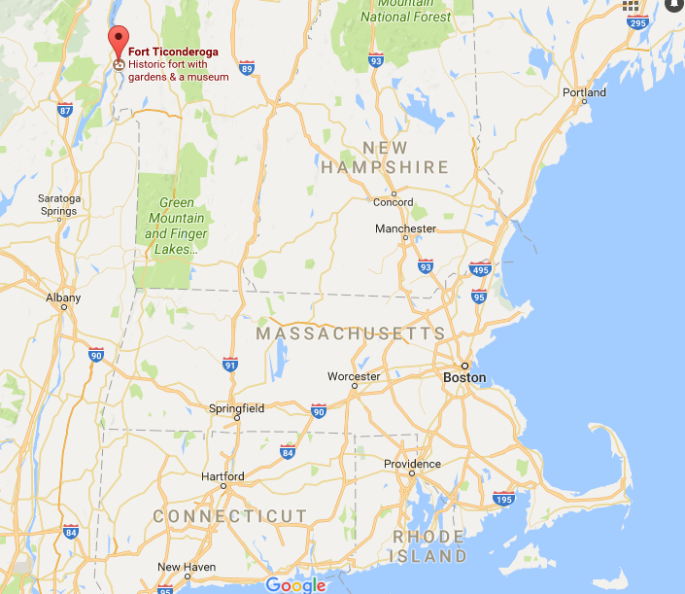

Slide 21
Battle of bunker hill
June 16, 1775
1200 militiamen under command of colonel William Prescott set up fortifications at bunker hill – across harbor from boston
British tried to drive americans out of location
British charged
Americans fired and british retreated
British charged 2 more times
British won – suffered heavy losses of 1000 dead and wounded
“a dear bought victory, another such would have ruined us.”
--british officer recorded in diary

Slide 22
Choosing sides!
loyalists
patriots
Loyal to Britain
Didn’t consider unfair taxes and regulations good reasons for rebellion
Officeholders – would lose position if opposed king
Some thought Britain was the “winning side”
Determined to fight for independence from Britain
Wanted American independence – they would represent themselves!

Slide 23
https://www.youtube.com/watch?v=cMmwDJXWjwQ&t=46s

