Slide 1
Major Events Leading to the Civil War
A Common Craft Style Video Project

Slide 2
Directions
Your video team will draw ONE of the following topics to be the focus of your video. The bullet points underneath each topic shows what information should be in your video!
The Compromise of 1820 and 1850
The Dred Scott Decision
The Kansas / Nebraska Act and “Bleeding Kansas”
John Brown’s Raid on Harper’s Ferry

Slide 3
What is Common Craft?
A “Common Craft” Style Video is one where images tell the story as it is being read. AS someone is reading the script, images are moved in and out of the screen by other team members to correspond with the story being read.

Slide 4
More Directions
Research your topic!
Write a script first! Make sure the “story” addresses the bullet points for your event.
Once finished with scripts, begin making props that can be used throughout your story. Ask yourself, “what props can go with this sentence?” Hint: You need LOTS of props! There should never be a part of the production when no props are on the stage.
PRACTICE!!!! Lots of Practice! Work on timing! The reader needs to know what props should be “on stage” at specific parts of the story. The “stage crew” needs to know what props go where at specific parts. EVERYTHING HAS TO MATCH UP!
Be creative! Have Fun! Ask for advice if you need it!

Slide 5
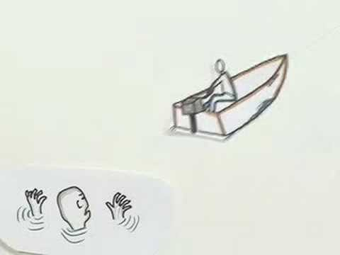
Let’s see an example…

Slide 6
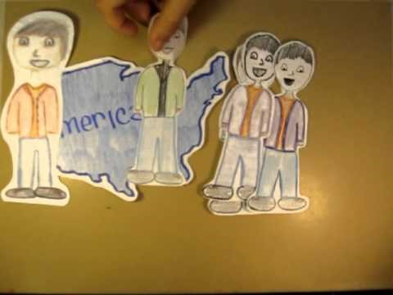
Let’s see an example…

Slide 7
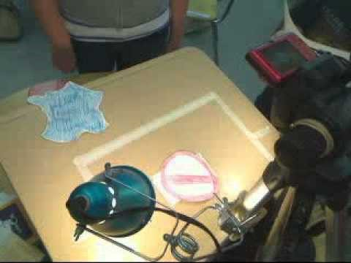
So how does it work behind the scenes…

Slide 8
Category | 3 | 2 | 1 | 0
Overall Content/ Message | The overall content was carefully constructed and made an impact. It was obvious that outside research was done. | The overall content was covered well. It was obvious that outside research was done. | The overall content of the video was not clear and lacking. There appeared to be no outside research. | The overall content was weak and left many unanswered questions.
Essential Elements | All essential elements were completed and included. | One essential elements was not met. | Two essential elements were not met. | It was obvious the group did not try to include the essential elements.
Images/ Creativity | The images were creative and gave a great overview of what the topic was about. They were clear and followed the script. | The images were basic and gave an overview of what the topic was about. The script was loosely followed. | The images did not give a clear understanding of the topic. They require some explanation to fully understand with the script. | The images didn’t appear to be tied to the topic. They did NOT match the script.
Script & Presentation | The topic was explained well. The presentation seemed rehearsed. | The presentation left some questions unanswered and could have used more rehearsal time. | The presentation was weak and obviously not rehearsed. | The group did not record a full video.
TOTAL POINTS | / 12 | Comments:

