Slide 1
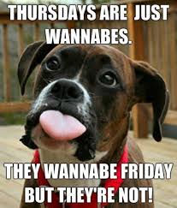
Good Morning!
Please clear off your desks for everything EXCEPT a pen.
Vocabulary Quiz – Hope you studied!
When finished, please turn your page over and READ quietly.

Slide 3
Essential Question
Why was Jackson against the National Bank and what were the effects of Jackson’s Bank War?

Slide 4
When asked of what is most likely
to be remembered from his two
terms as President, Andrew
Jackson replied....
"I killed the Bank."
Page 15

Slide 5
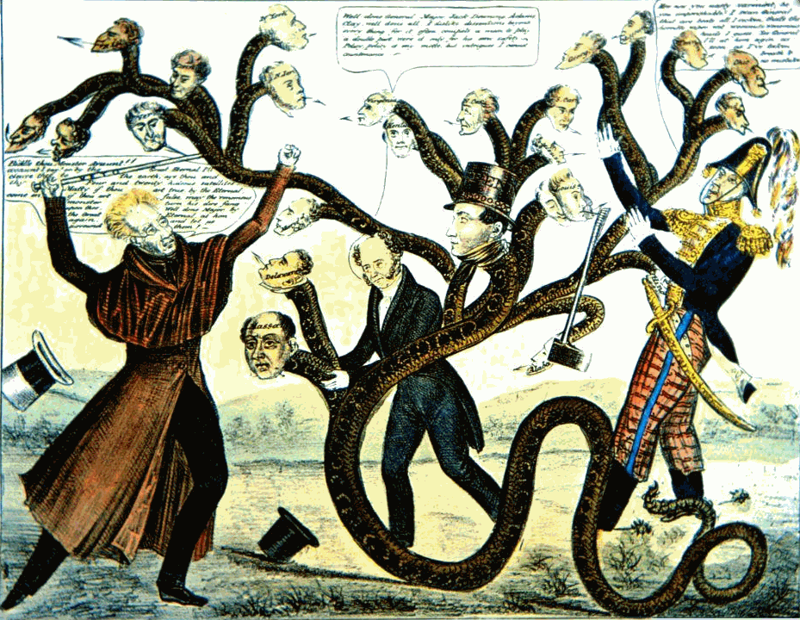

Slide 6
Let’s Read!
What really happened with the Bank?
What is going on?
Was your prediction on the picture correct?

Slide 7
Essential Question
Why was Jackson against the National Bank and what were the effects of Jackson’s Bank War?

Slide 8
Let’s Read!
Read the text “Jackson vs. The Bank of the United States”.
What does epitome mean?
Who is Henry Clay?
What does charter mean?
Who is Nicholas Biddle?

Slide 9
